Slide 1
Inspiration from Nature
Telling a story with a tree

Slide 2
Proposals
Every tree should tell a story
The story explains what has happened to a tree
Having a clear story helps us make visual ‘sense’ of a tree
Without a story trees look odd

Slide 3
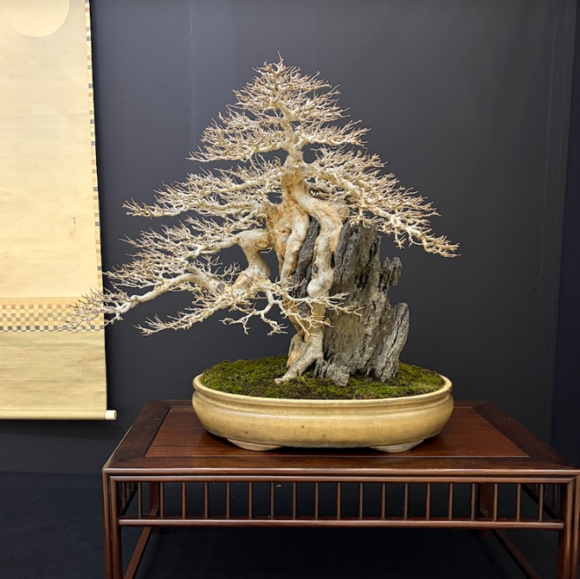
Reading a Tree
Each tree can tell us its history
Form = event + response
Why important?
Very jarring when this not followed
Mismatched features on a single tree

Slide 4
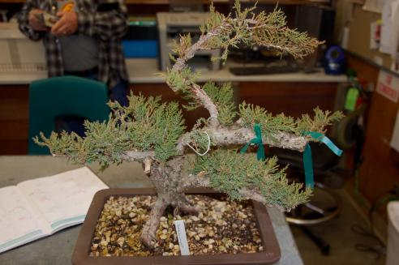

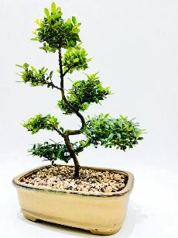
How to write a ‘story’
Understand the species
To style a tree ‘like a tree’ you must understand what your species should look like
Understand the environment
Story is a sequence of events over time that your tree has survived but that have added character to it

Slide 5
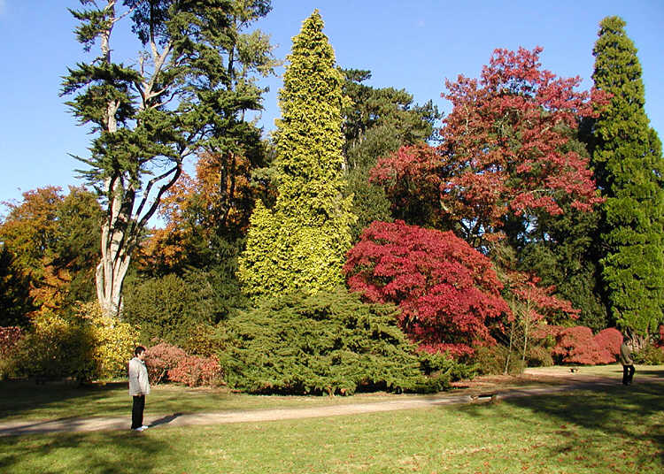
Understand the species
How many species?
How are you telling them apart?
Species Characteristics

Slide 6
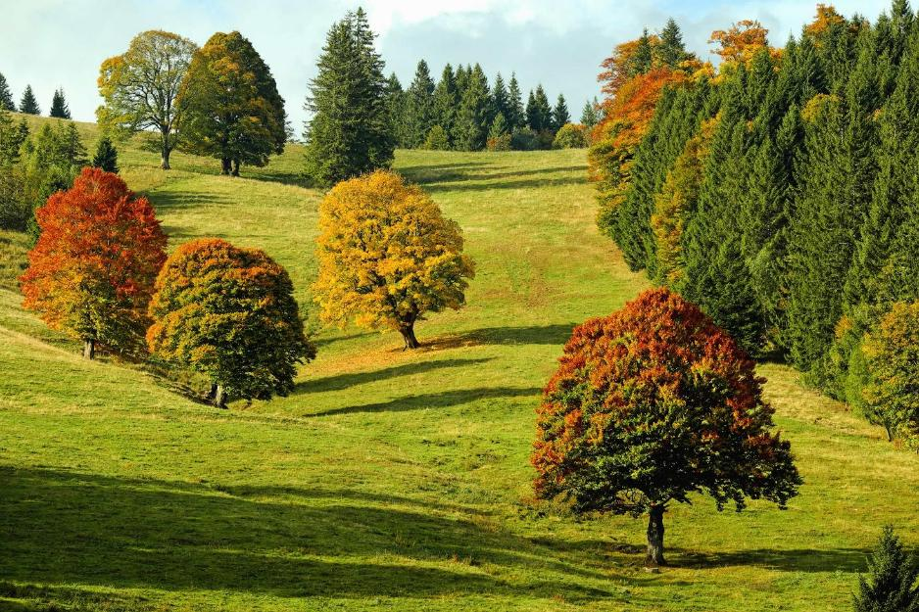
Tree ID
Up close you can use:
leaves,
buds,
fruit and
twigs
Bonsai views trees from an illusion of distance
Shape and branch placement are crucial

Slide 7
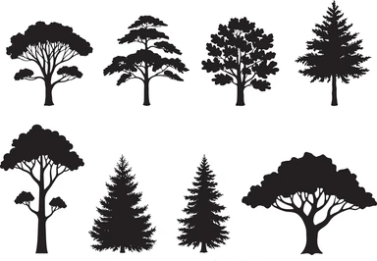
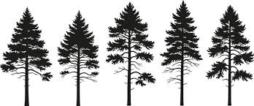
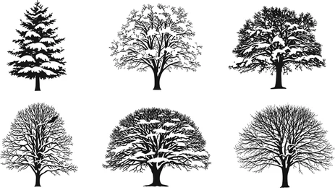
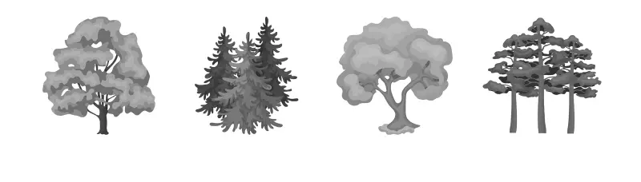
Telling trees apart
Conifer or Broadleaf?

Slide 8
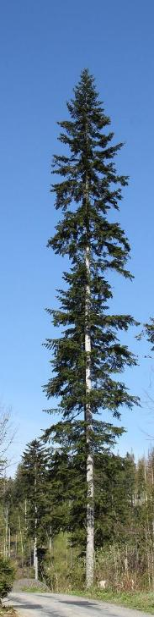
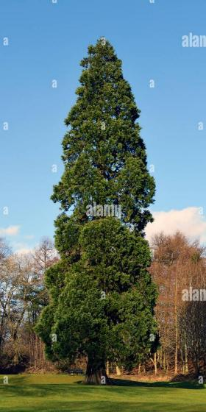
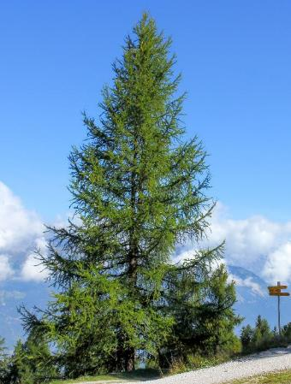
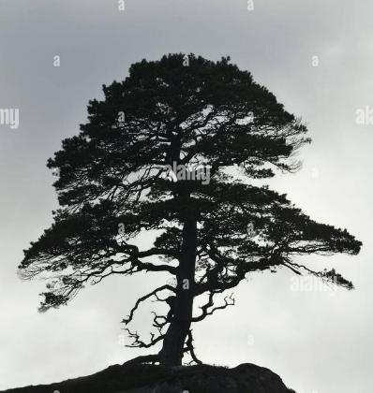
Which conifer?
Notes:
Pine: Larch: Wellingtonia: Silver Fir
Consider spread, branch angle, foliage placement on branch, height to trunk ratio, foliage texture, etc

Slide 9
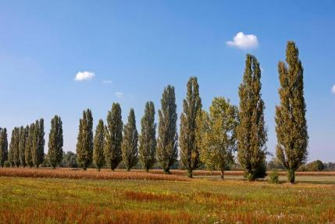
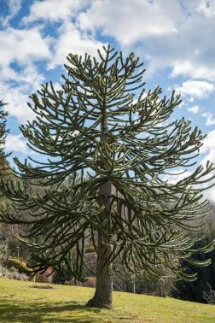
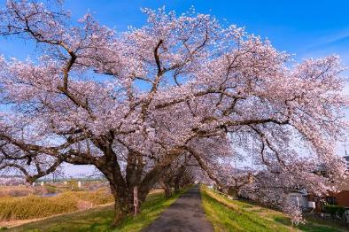
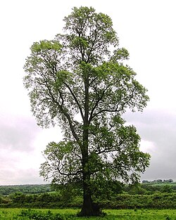
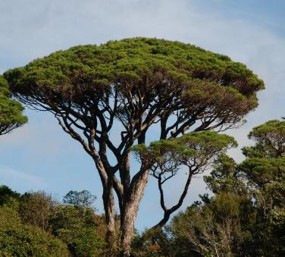
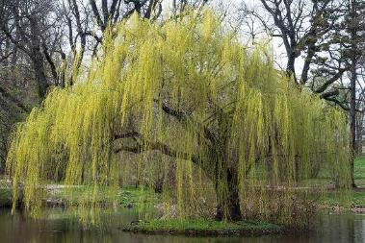
Notes:
Cherry, Lombardy poplar, monkey puzzle, Sone pine, Elm, Weeping Willow
All trees fundamentally different but displaying their nature essence

Slide 10
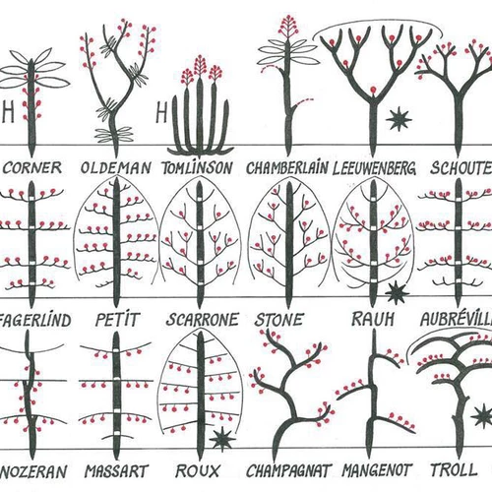
Species differ!
Location of bud placement and
branch growth
‘Unit of reiteration’
Apical dominance
Sets overall tree shape
and explains why a ‘pine looks like a pine’
Tree Architecture
by Francis Halle

Slide 11
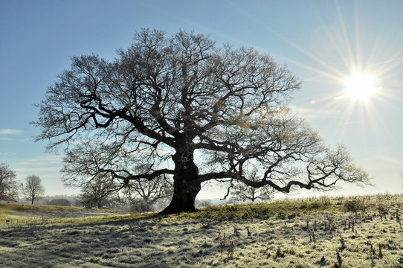
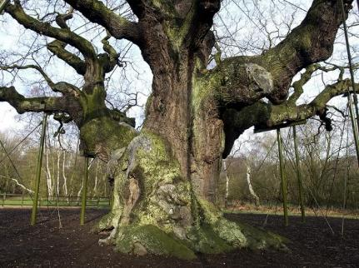
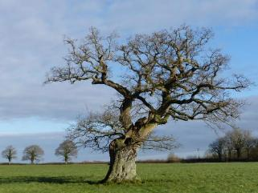
Oak

Slide 12
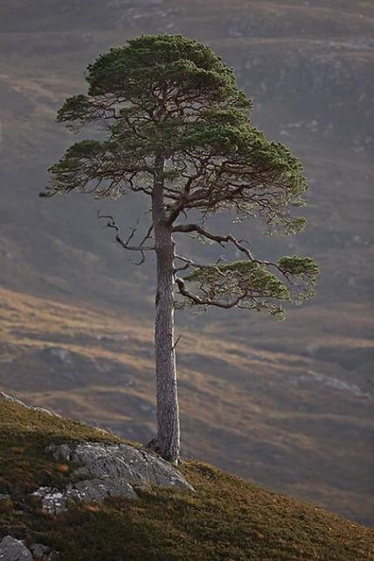
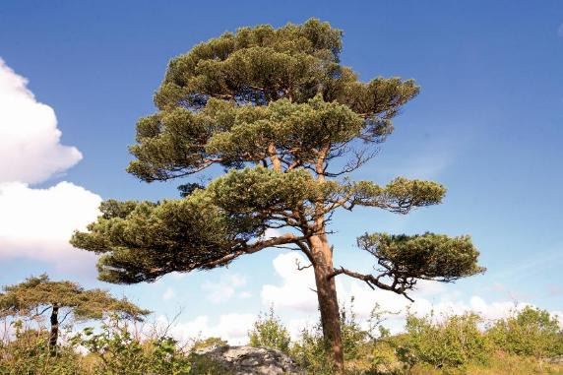
Scots Pine

Slide 13
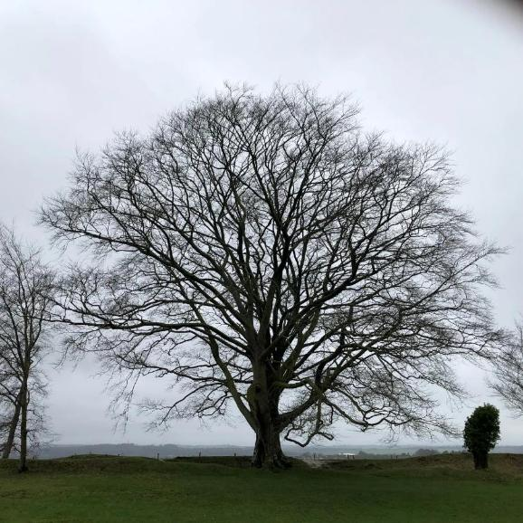
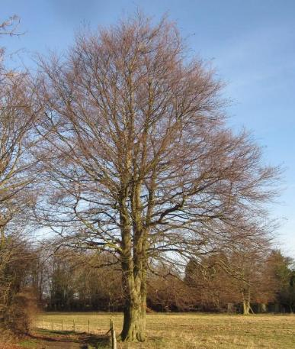
Beech

Slide 14


Understand the environment
Tree by itself = genotype
Tree + environment = phenotype

Slide 15
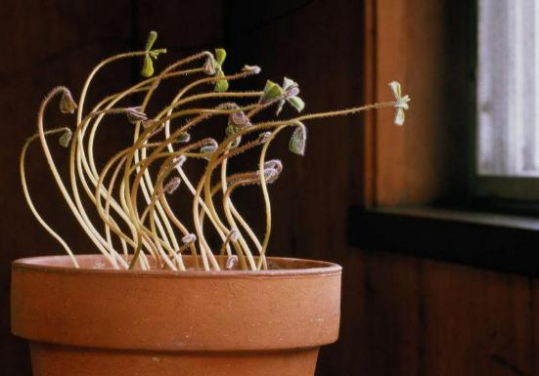
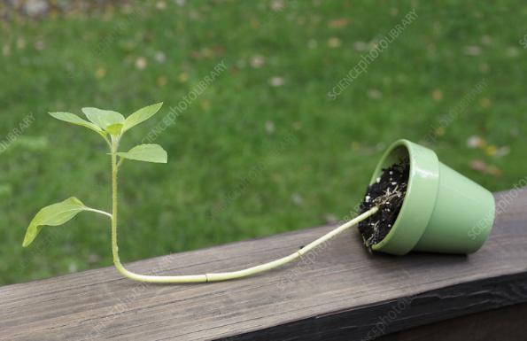
Phototropic (light) vs Geotropic (gravity)

Slide 16
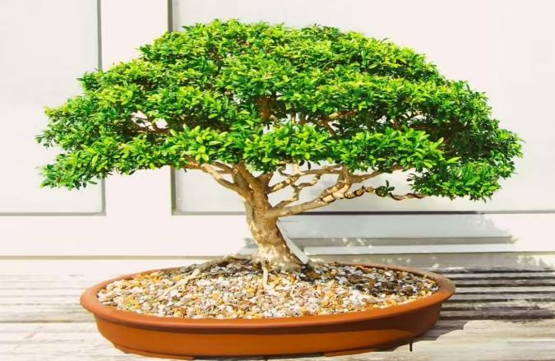
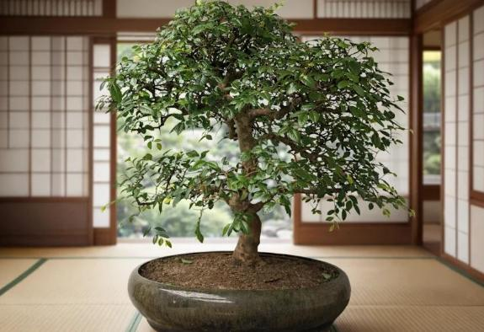
Phototropism = lop-sided

Slide 17
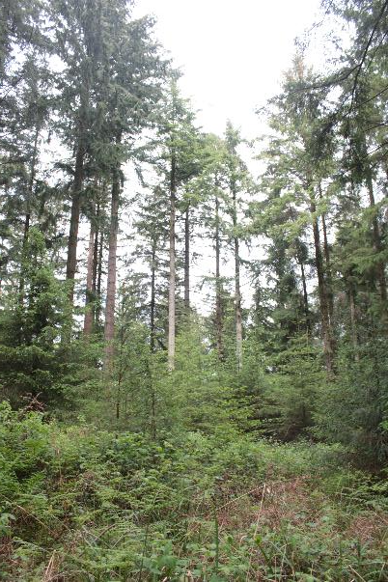
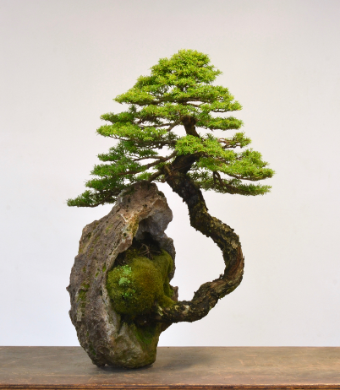
Geotropism
All trees grow upwards initially,
even in low light levels..
..or quickly revert to upright if not

Slide 18
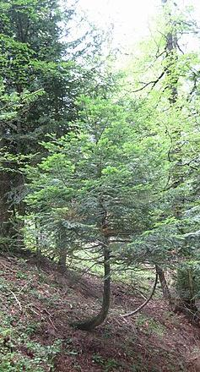
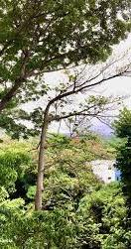
Which is which?
Phototropic
vs
Geotropic

Slide 19
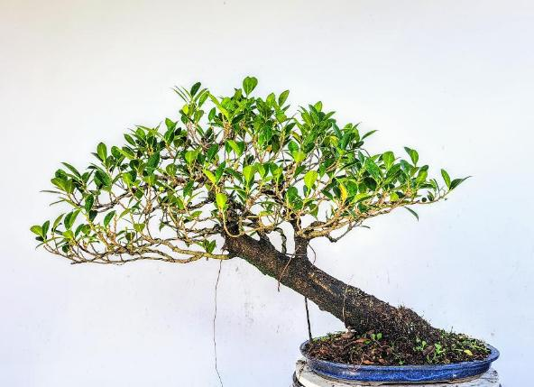
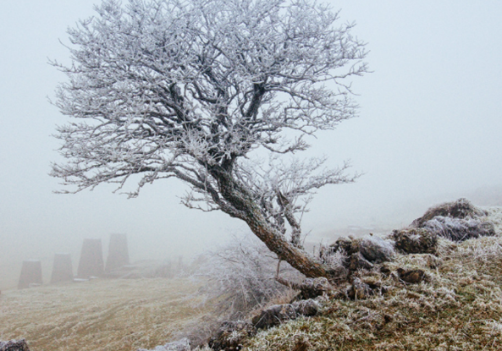
Phototropism in action
Healthy canopy
Evenly balanced crown but off-centre

Slide 20
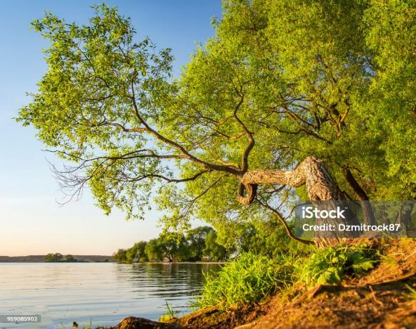
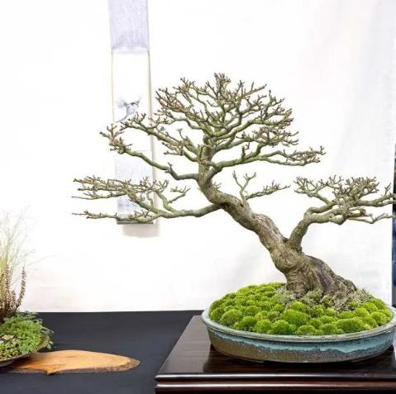
What is the story?

Slide 21
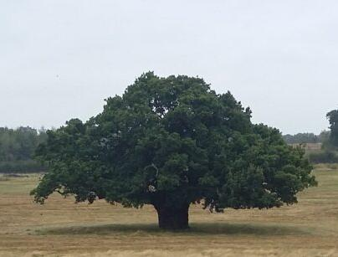
We generally represent individual open grown trees
Low, wide spreading
heavy long branches,
no need to develop height,
Spreads for stability.
Browse line to ‘lift’ crown.
Wide trunk, short height
Light can reach trunk so will cause new buds to develop

Slide 22
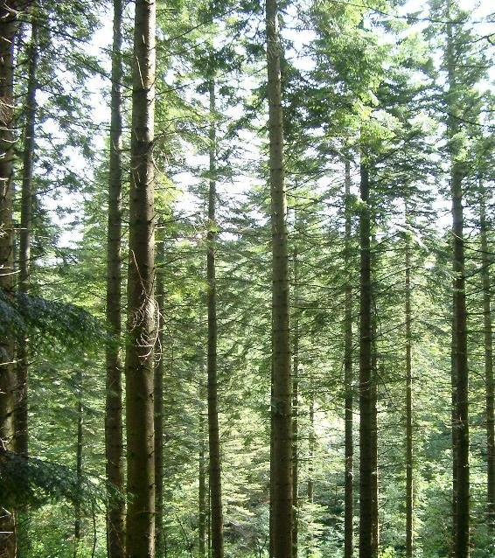
Forest group
Need to grow tall to reach light,
Straighter
Sheltered,
little low branching
Upper branches angled upwards,
narrow crown.
Slender trunk, very tall

Slide 23
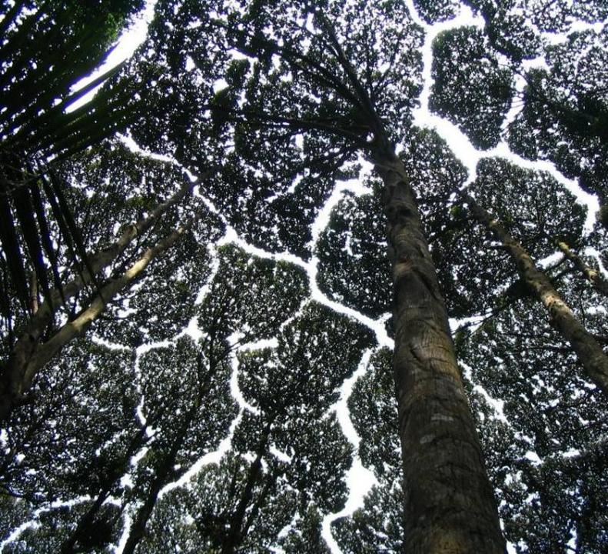
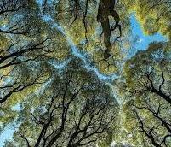
Forest trees – ‘crown shyness’

Slide 24
Mixture of dominant and suppressed trees
Larger central tree:
  Shaded lower branches
  Branches higher up can spread wider, lower branches shorter
  Different first branch height to smaller trees
Edge trees
  Phototropic if species allows
  Dominated and less vigorous
  Likely to be thinner
  Longer branches on outside (one-sided)

Slide 25
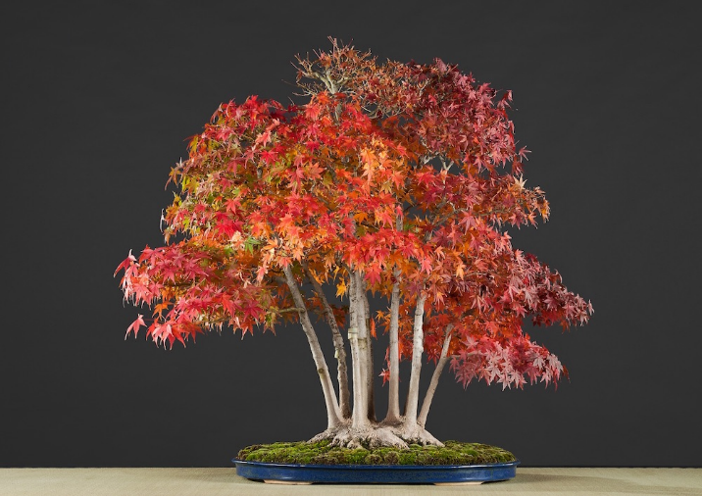
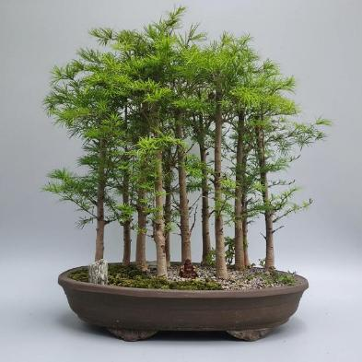
Trees in Company
Outer stems forced outwards

Slide 26
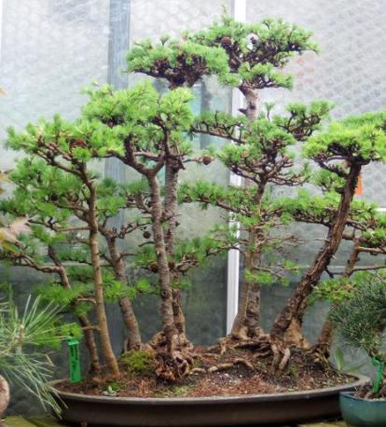

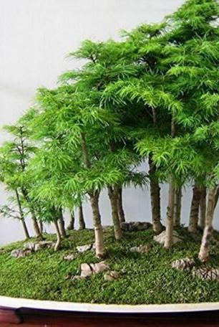
Trees in company
Central tree dominate or would have been suppressed

Slide 27
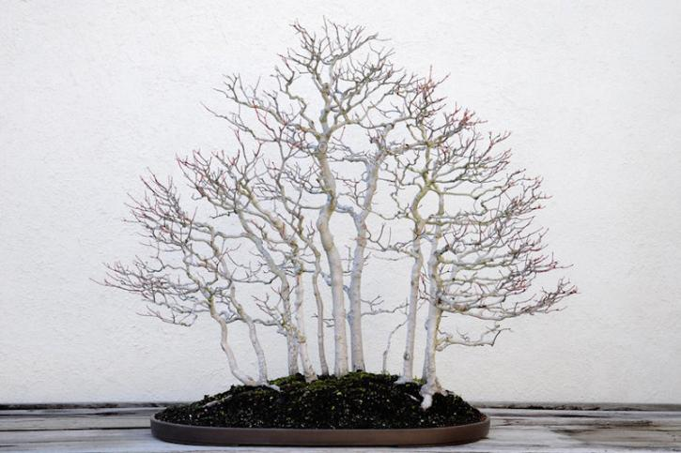
Neighbours control branching through shade

Slide 28
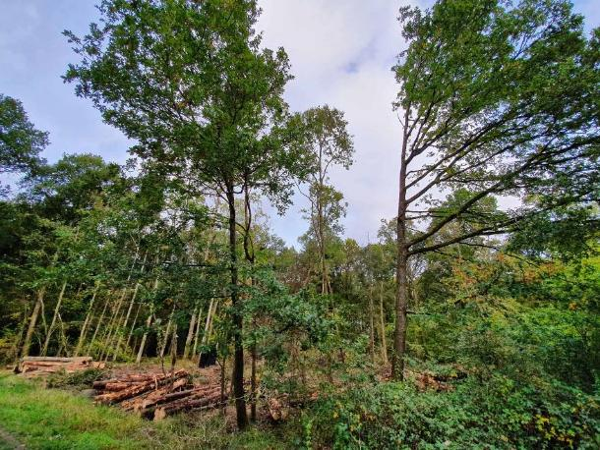
Tree released from shade

Slide 29
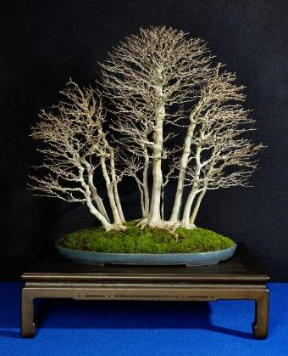


Good, Bad and Ugly

Slide 30


Group can mimic individual

Slide 31


What’s the Story?

Slide 32

QUESTION:
Why does a tree slant?
Windswept?
Sudden gust or persistent shaing
Branches need to agree with trunk
Growing to the light?

Slide 33

Gentle gust

Slide 34

Video of wind
https://youtu.be/98j0V5ftlpE
Inertial mass damping
Whole tree in a single direction is not usual!

Slide 35

Static tree with gentle wind.
All branches on one side bend – would it look right when straightened?
Trunk can be variable

Slide 36



Chronic wind shapes growth
Trunk shelters branches
Nothing on one side as desiccating wind kills foliage
Persistent prevailing wind

Slide 37



Gently chronic
Unbalanced crown
Longer branches on sheltered side

Slide 38


Can cause deadwood to most exposed branches

Slide 39


Butress roots formed
Chronic wind should show in adaptive growth
Butress roots develop
Conifers grow ‘props’
Broadleaves grow ‘cables’

Slide 40

Windblown stem – upright then at an angle
Logical implications – branching structure?

Slide 41

What’s the story?
Tree was upright but then leaned.
Branch angle shows previous plane
New growth geotropic

Slide 42


Exposure once above a sheltering object
Tree behind a wall
Tree in crescent pot

Slide 43



…but can look odd

Slide 44


What’s the Story?
Opposite wind direction

Slide 45

What wind causes this?
Leaning trunk
Deadwood shows branches grew to left
Lower branches descend untouched by wind

Slide 46


What’s the story?
A tree with this much lean is unable to stand by itself, elongated branches would need support

Slide 47


Good or Bad?

Slide 48


Good or bad?
Why is initial growth to left, then blown to the right?
Tree has twisted ‘into’ the wind, then turned more than 180
Foliage now in sheltered place

Slide 49


Similarities?

Slide 50
Deadwood
Aging of a tree

Slide 51

How trees are built
How many fractals in tree architecture?
Lowest early branches will be lost as tree obtains height
Primary reiteration forms first natural fork ‘spring of the crown’
Look for subsequent reiterations as crown ‘repeats’

Slide 52

Bonsai rules?
Branch size and placement – larger at the base?

Slide 53

Branches aligned to the horizontal plane on either side of tree
Lower branches curving down
  (phototropism)
Middle horizontal
Upper more upright

Slide 54

Why does deadwood occur?
Decline in function of a branch
Tree sheds limb when net energy cost
Catastrophic loss (windsnap)
Idea of natural lifecycle

Slide 55

As trees age, they start hollowing

Slide 56

Stages of aging

Slide 57



Acropetal mortality
Lower branches die due to shade from above
Canopy lifting, trunk height increasing
Eventually form branches that will be sustained for long period
Juvenile shape with strong apical growth

Slide 58


Centrifugal mortality
Inner foliage dies as energy flows to tips
Branches elongate
Hydraulic maximal
Loss of apical hormonal control leads to separate domes
Biggest possible stage of tree size
Some internal hollowing possible but aerial rooting will fill cavity
External cavity rapidly occluded

Slide 59




Centripetal Mortality
Unable to supply full canopy
Gaps appear in crown
New internal trunks develop
Hollowing evident
Stag-headed
Separate functional units in tree

Slide 60


Stages in Bonsai
Initially appear similar, but trunk diameter out of scale

Slide 61





Ancient Oak
Retrenchment
Stage-headed

Slide 62


Jins
Only works logically if in space where branch is clearly missing
Angle of jin needs to agree with other branches
Tree response to loss of branch (woundwood)
How to explain loss of single whole branch?

Slide 63


Don’t confuse with disease!

Slide 64


Stages in Bonsai - ancient

Slide 65


Formal upright + deadwood
Explain the story of what killed a branch but left the rest of the tree canopy intact?

Slide 66

What’s the story?
Strong upright growth used as deadwood
Foliage pads formed evenly
Initial lean in trunk, then straight
Branch on right directly vertical

Slide 67


Live veins –cambial columns

Slide 68


Live veins – functional units

Slide 69



What’s the (best) story?

Slide 70

Stages of hollowing

Slide 71


Hollowing - story
Where is hollow?
How did it start?
How did it spread?

Slide 72



Inappropriate hollowing
Too early in developmental stage shown
Would it have healed over?

Slide 73

What’s the story?
How did the would occur?
How did it hollow the trunk?
Why did it not follow the grain?
Why is it not spreading?
Or, why is it not healing?

Slide 74

Final exam
What’s the story?

